Slide 1



Applied Data Analysis (CS401)
Lecture 1
Intro to ADA
16 Sep 2020
Robert West
Notes:
[length: just about 1 minute over in total; first half: 50-55 min]

Slide 2


Important websites
http://ada.epfl.ch
Your main entry point. All materials linked from there.
https://ada2020zulip.epfl.ch
Main communication channel. Sign up here with your EPFL email address.
https://github.com/epfl-ada/2020
Used for homework and final exam.

Slide 3
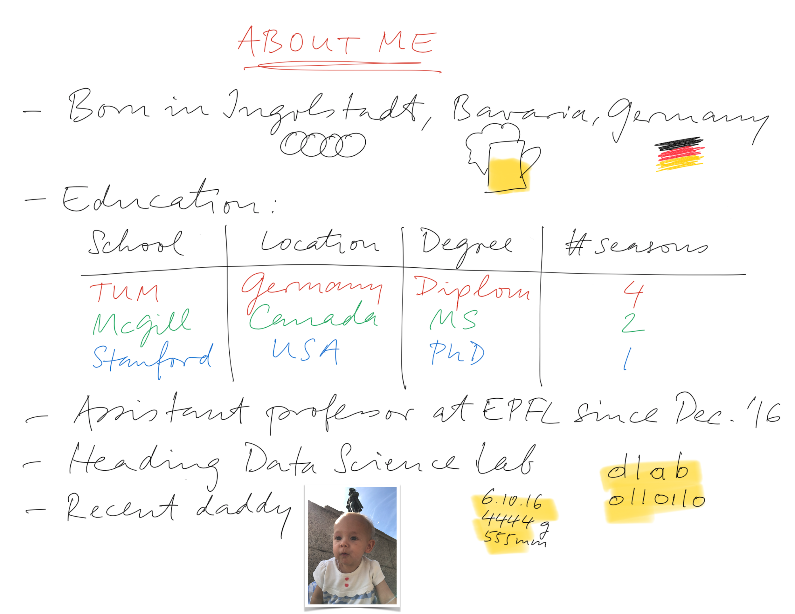


Notes:
At Stanford: internships at Google, Yahoo, Microsoft; worked closely with WMF
All have changed logo -- and now even EPFL!

Slide 4
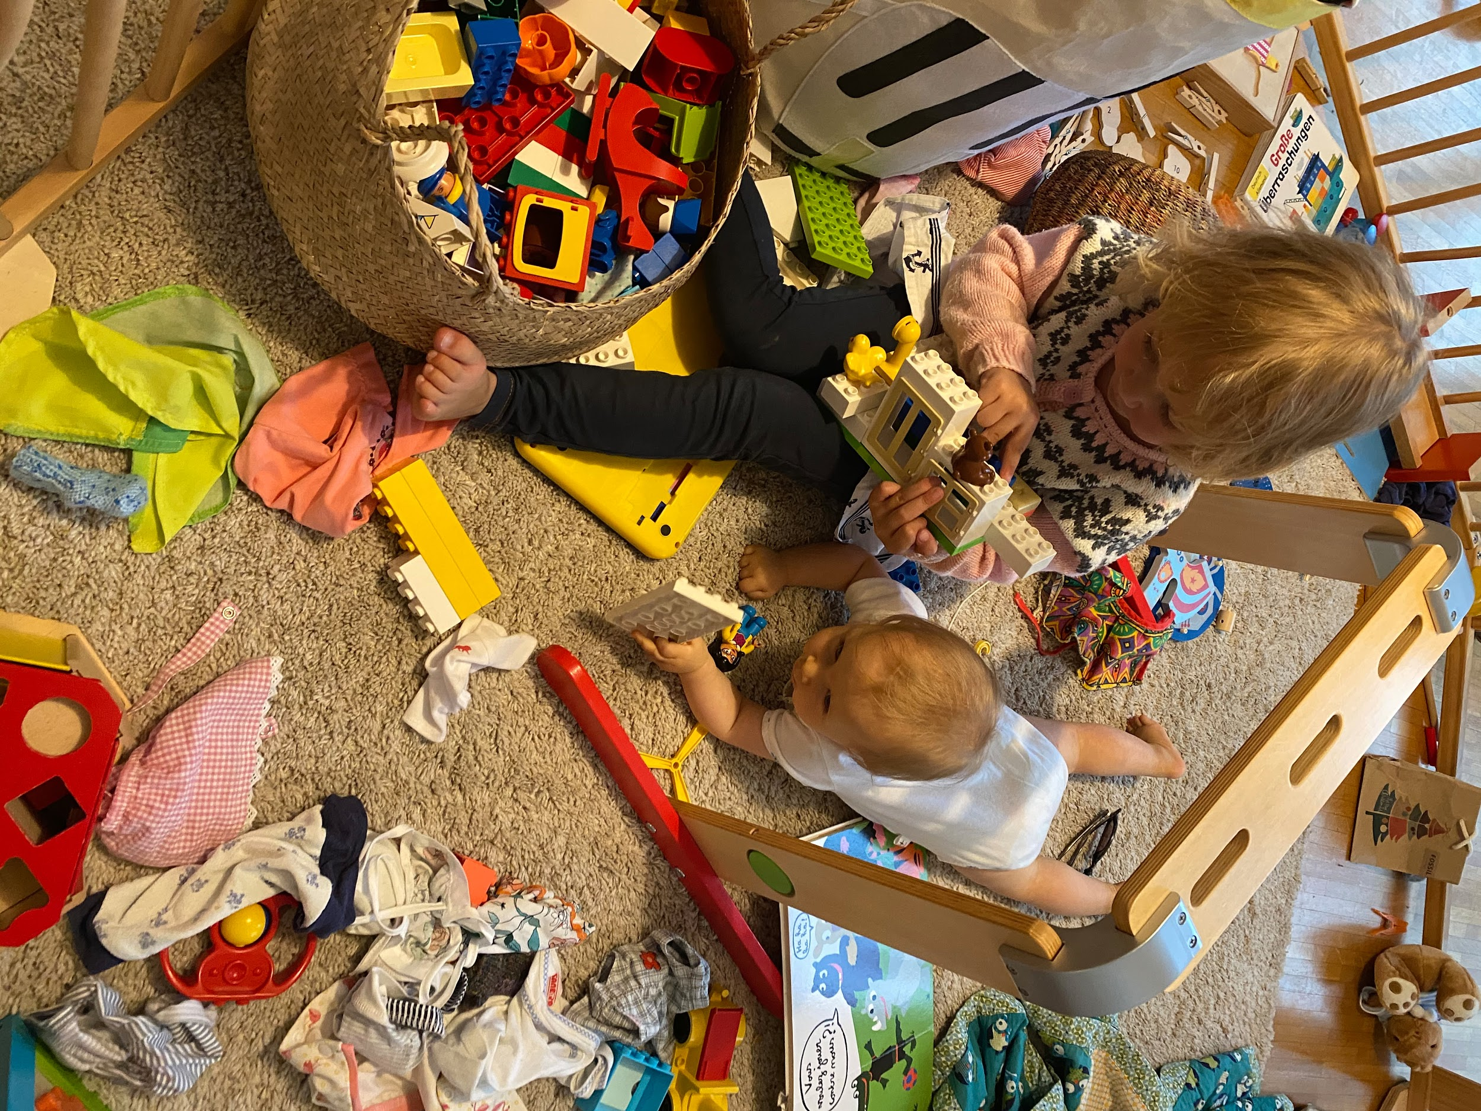
double
Notes:
Clara’s bday rather a manifestation of my inclination to get stuff done last minute: 30 Dec

Slide 5
double

Slide 6
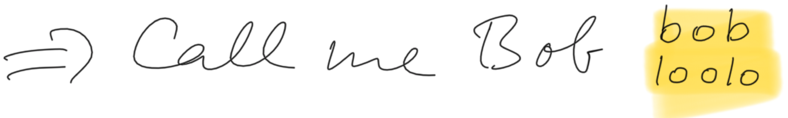
double
Notes:
Also: ADA

Slide 7
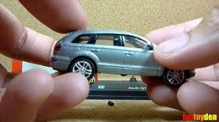
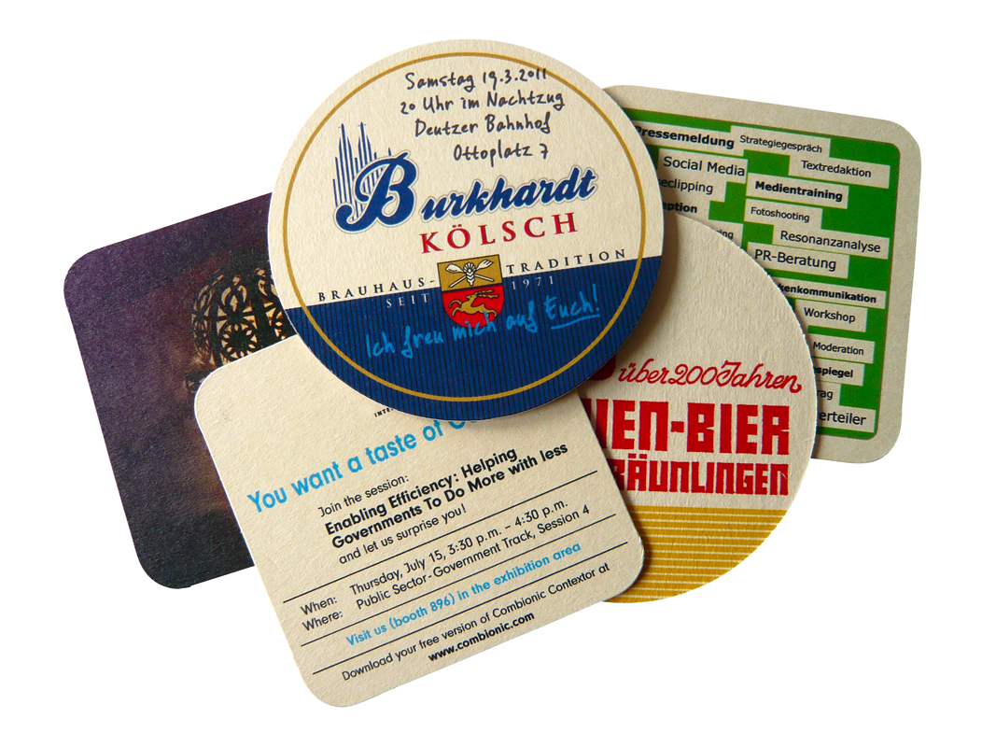
My path toward data science
Notes:
Collector’s mind
Coasters: rich, structured data; Excel spreadsheet
Early adopter of Internet within community: advantage
Spamming people by scraping email addresses (by hand, writing them on a piece of paper)
Did stupid parts of data science, in a stupid way
But not ashamed of it: Vapnik anecdote
I sold my entire collection (thousands of coasters) for a fistful of dollars before moving from Germany to Canada,
but to this day, my collector’s mind plays a role in my research: warm fuzzy feeling when good dataset is obtained

Slide 8
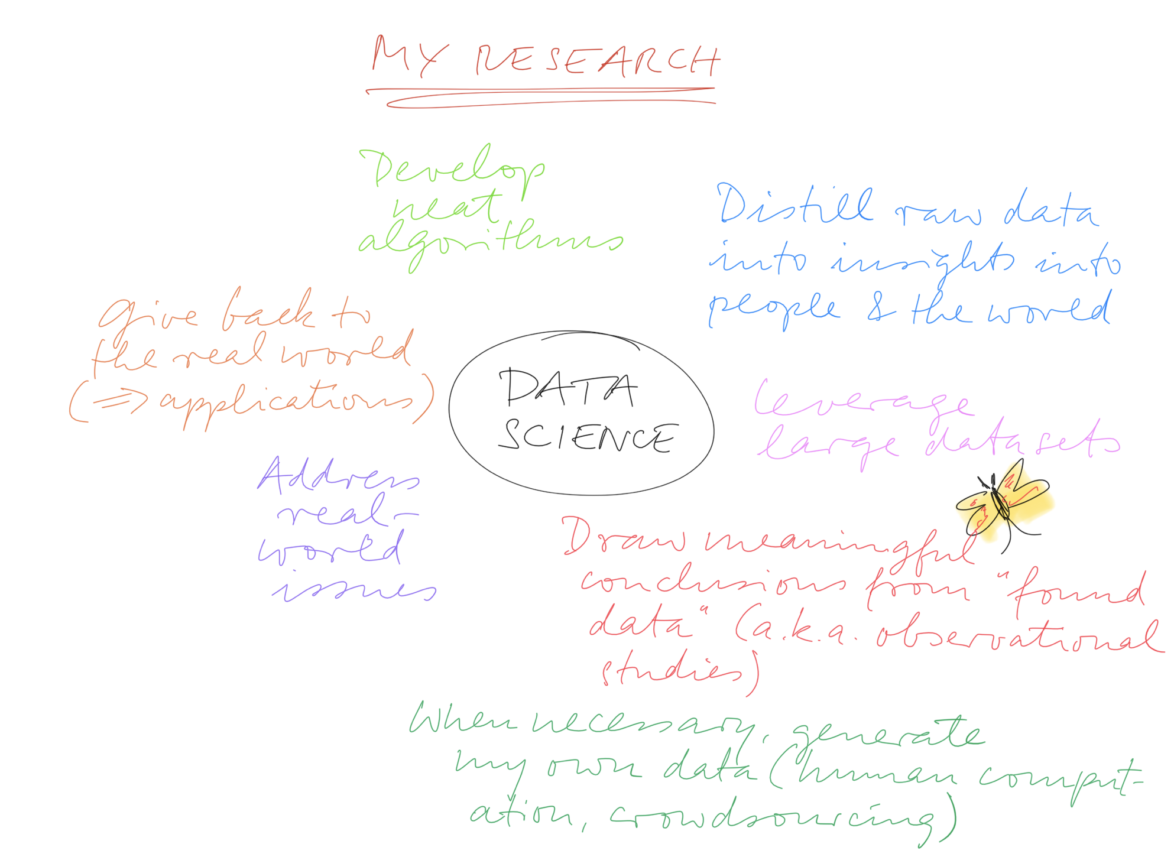

Slide 9
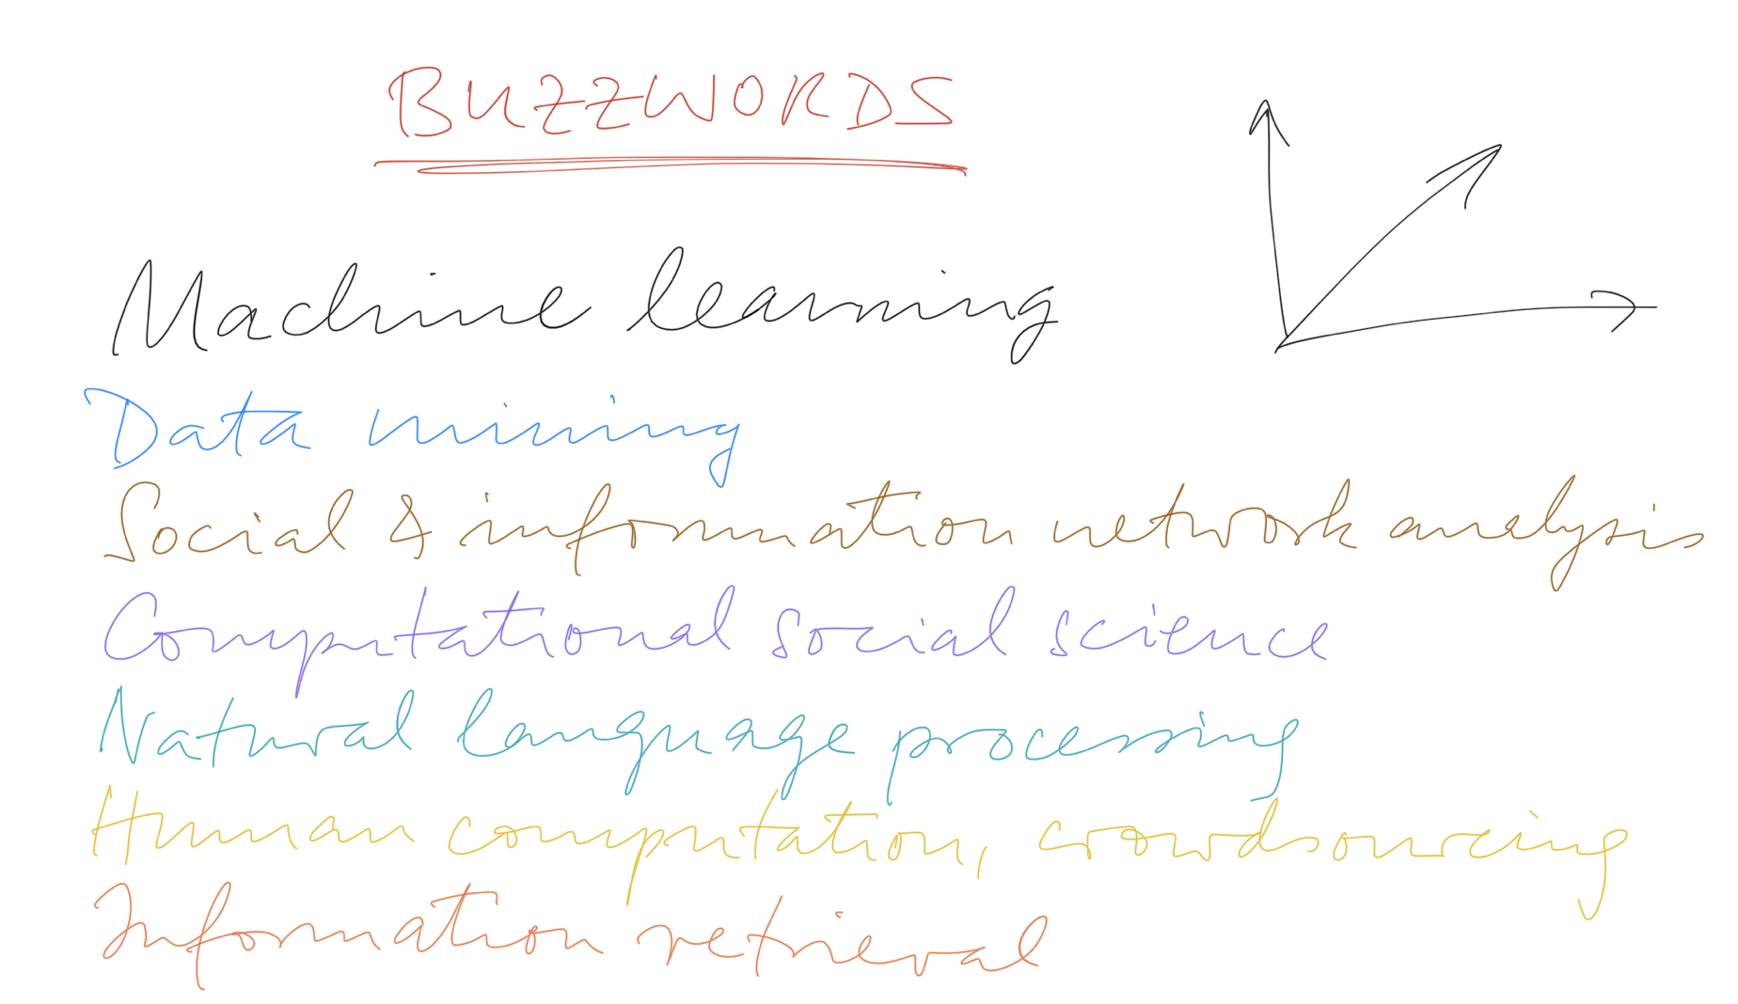
Notes:
Semester projects: motivated and top-notch students always welcome

Slide 10

Data analysis
“... the process of inspecting, cleaning, transforming, and modeling data with the goal of discovering useful information, suggesting conclusions, and supporting decision-making.”
“Data analysis has multiple facets and approaches, encompassing diverse techniques under a variety of names, in different business, science, and social science domains.”
Notes:
This was Bob West’s personal take on data science
Let’s quickly look at a more objective definition, from WP (you’ll notice, I love WP!)
(1) we’ll cover all of these!
(2) Attendees from all schools of EPFL

Slide 11
Applied data analysis
This course is about breadth, not depth
“What methods, principles, and tools are out there?”, rather than “How can I become an expert in deep learning for computer vision applied to images of cats?”
Data science is a fast-paced, shifting field
Obsessing on one tool or technique won’t pay off in a few years
Be ready to explore and keep learning on your own
Goal of this class: Enable you to conduct a full-fledged data science project from start to finish
That said, depth matters, too…
Complementary courses:
Machine learning
NLP
DIS
Data viz

Slide 12
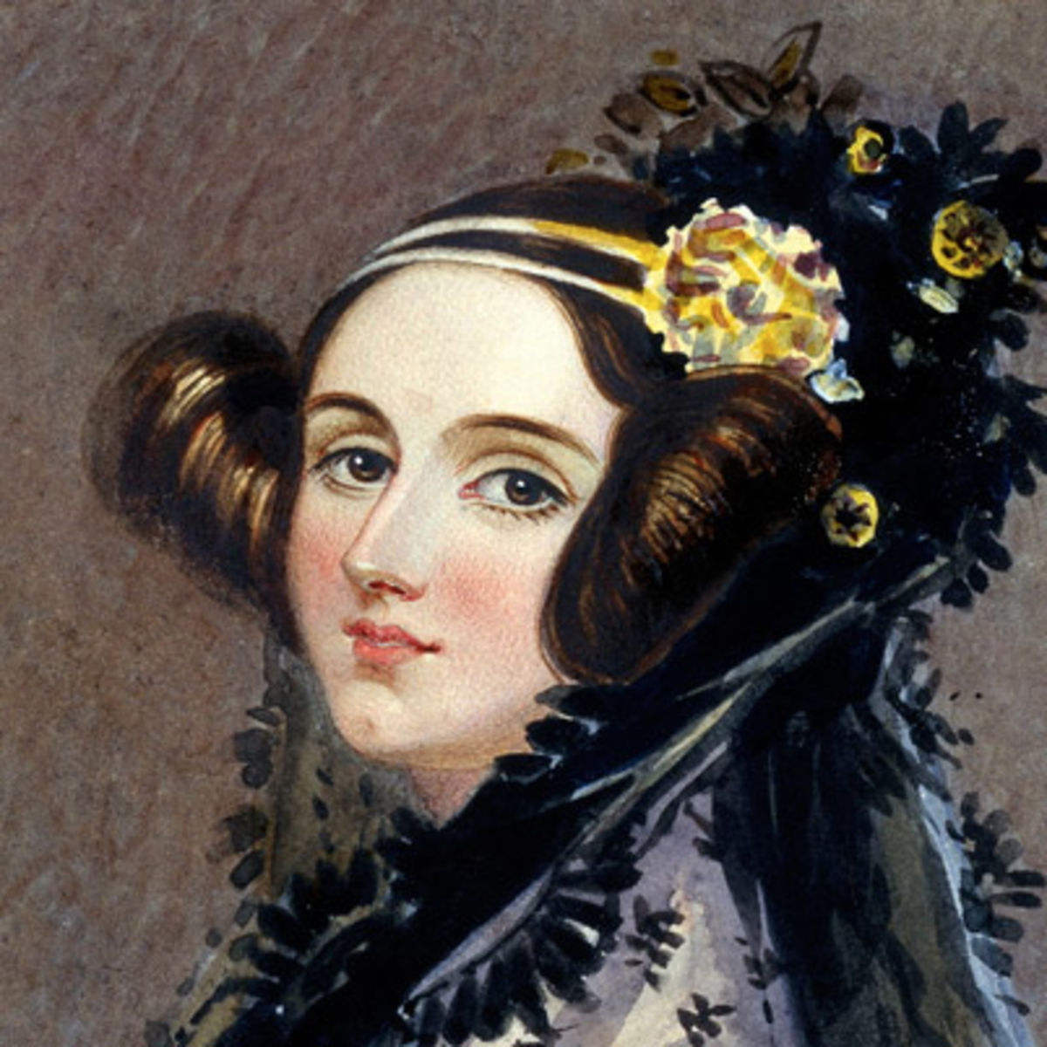
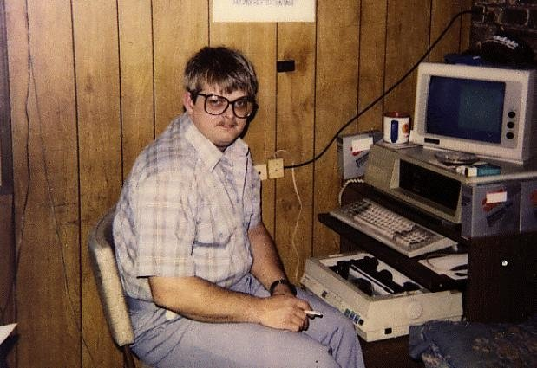
Let’s call this course Ada, not A-D-A, in honor of Ada Lovelace, “the world’s first computer programmer.”
https://en.wikipedia.org/wiki/Ada_Lovelace
Notes:
Who knows who this beautiful lady is?
This beautiful lady is Ada Lovelace, the world’s first computer programmer, early 19th century
Good old days… sigh. Now they look like this
(used to have Richard Stallman here…)

Slide 13
Syllabus
Data wrangling
“Slicing and dicing”: obtaining, preparing, handling data
Data visualization
Exploration of data, communication of results
“Read the stats carefully”
How to support (and be suspicious of) claims about data
Regression analysis
How to disentangle datasets with correlated variables
Observational studies
How to deal with “found data”
Correlation != causation

Slide 14
Syllabus (cont’d)
Applied machine learning
Supervised learning
Unsupervised learning
Practical issues of machine learning
Handling specific types of data
Text
Graphs, networks
Scaling up to terabytes and beyond
MapReduce, Spark

Slide 15
Meeting logistics: Lectures
Wednesdays 8:15 - 10:00
⅓ of students may join in person in Rolex Forum
I’d love to see you in person, so do come if you can!
⅔ of students watch lecture on Zoom
Live stream: https://go.epfl.ch/ada2020-zoom-lecture
If meeting reaches capacity of 300 attendees (and only then!), connect via the “overflow room”: https://go.epfl.ch/ada2020-zoom-lecture-overflow
Must be logged in to Zoom
Passcode 811811 (mnemonic: “ADA-leven ADA-leven”)

Slide 16
Meeting logistics: Lab sessions
Fridays 13:15 - 15:00
Zoom only (must be logged in, passcode 811811), not recorded
Live session: https://go.epfl.ch/ada2020-zoom-lab
If meeting reaches capacity of 300 attendees (and only then!), connect via the “overflow room”: https://go.epfl.ch/ada2020-zoom-lab-overflow
You solve exercises we make available the day before, can ask questions and get help from assistants
Can connect with assistants in the spirit of office hours
Sometimes brief tutorials
Possibly invited speakers from industry and academia

Slide 17

Notes:
We’re all in the same boat
New situation for all of us
Things will evolve
Please be patient with us as we find good ways to navigate this new territory
If you think you have ideas on how to improve things, let us know (you see many other classes, I don’t)

Slide 18
Corona remarks
In class, you must wear a mask
I will take mine off when far from you, will wear it when close
Feel free to zoom in even when physically attending class
For interactive elements such as Zoom chat, Zoom polls, Zoom breakout rooms (trial later!)
Mute speakers or wear headphones
Ask questions!
In room: raise hands or use Zoom chat
On Zoom: use chat. We can unmute you so you can ask in person (if you want).
Notes:
May use more advanced Q&A platform later; we’ll start simple for now.

Slide 19

Grading
33% Homework assignments (2)
Involving skills required from data scientists
Groups of 3 students (may switch groups after Homework 1)
Homework of 2017, 2018, 2019
33% Final exam (date TBD)
Mini data analysis project
Done on laptop, individually, on campus 😱
Final exams of 2017, 2018, 2019
33% Project (more details soon)
Replication of data analysis from published scientific paper
Done individually
Freestyle extension of replicated data analysis
Done in groups of 3 students (same as for homework)
Projects of 2017, 2018, 2019 (but there no replication part earlier)
This class will be hard work,
but it will get you a job.
Notes:
Where’s the extra %? Weird times.
Teams: there will be mechanism to report freeloaders (red button); taken very seriously
Button must be pressed early on, so we can sort out the situation on time. The button is not intended as a post-hoc grade improvement!

Slide 20
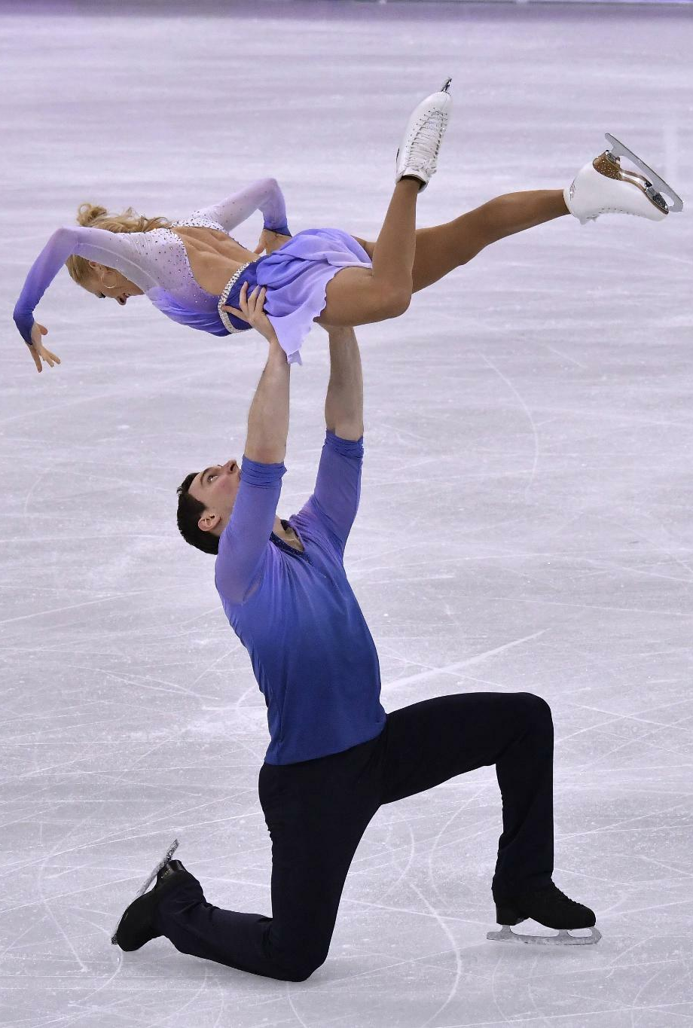
Project
2 parts (see previous slide)
(1) Replication of existing paper
(2) Creative extension
For (2), you need to form and pitch a crisp idea, then implement it
May combine with additional datasets (but more risky)
Goal: not a loose collection of results -- tell a story with the data!
Nice example data story
Notes:
When using own dataset: need to convince us that it’s feasible

Slide 21



Homework and projects: GitHub
De-facto standard for managing and sharing code
All students in this class need a GitHub account
Homework and project submissions done via GitHub
Notes:
Nice side effects:
Piggyback on GitHub timestamps for exact submission times
Can recognize freeloading

Slide 22
Main communication channel:
Open-source Slack alternative
Nice mix between Slack and email
Channel: https://ada2020zulip.epfl.ch
Sign up here (use your EPFL or UNIL email address!)
Install desktop and mobile clients
Mandatory! We’ll send important announcements on Zulip only
Recommended to use Zulip also for private team communication

Slide 23
General note on communication
Multiple platforms used in ADA for various tasks (as in real life): Zulip, GitHub, Google docs, ADA website
To avoid confusion,
familiarize yourself with communication guidelines
all materials will be linked from the website as a central point of entry: https://ada.epfl.ch
all discussions will take place on Zulip

Slide 24
Group registration
Must form teams in 2 weeks, starting now!
Get started immediately to find 2 teammates
By Wed 30 Sep 23:59, complete the registration form (to be done by each team member individually): https://forms.gle/B1djbTP6rB4CEriq6
Can change team after Homework 1 (but try to avoid it)

Slide 25

Prerequisites
Basics of
probabilities and stats
databases
programming
You won’t survive if you can’t program
Homework, exam: Python required
Project: up to you, but we support only Python
Brush up your Python skills (many great online courses out there)

Slide 26
Python environments
Homeworks and exams to be done as Jupyter Notebooks
You will submit a pre-executed .ipynb file
We don’t care how you produce it
Option 1: local Python installation (e.g., Anaconda + JupyterLab)
Option 2: Google Colab = notebook hosted by Google
To get started: come to Friday’s (online) lab session (“Tutorial 0”)
“Homework 0”: do it yourself at home after lab session (optional, not graded)
Doing Homework 0 the best way of making sure you’re set up correctly for later homework, project, exam

Slide 27





Python++

Slide 28

POLLING TIME
Anastasiia: please start the first-ever ADA Zoom poll!
Everyone: please vote! (Only available via Zoom call)

Slide 29

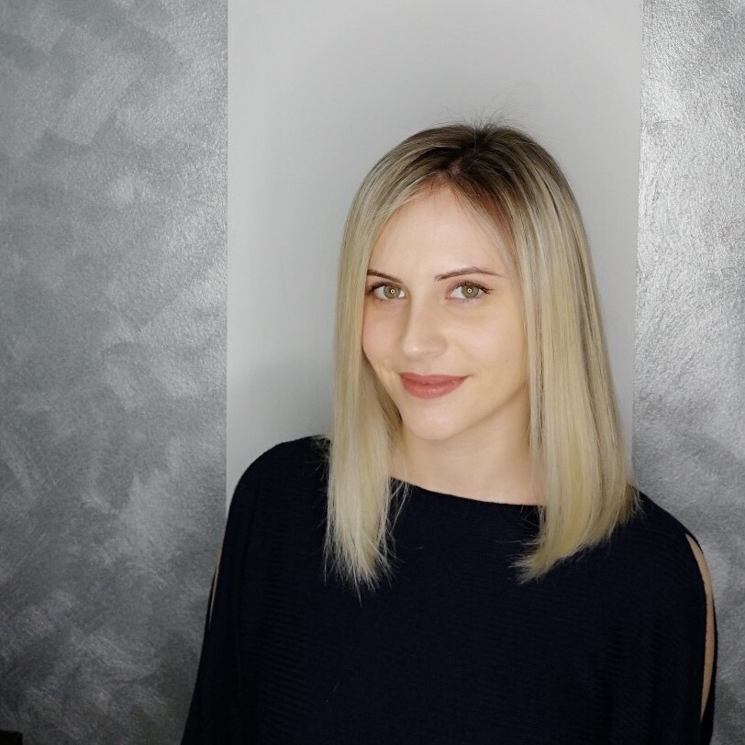
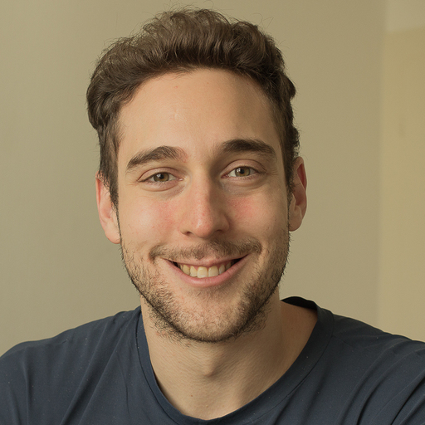
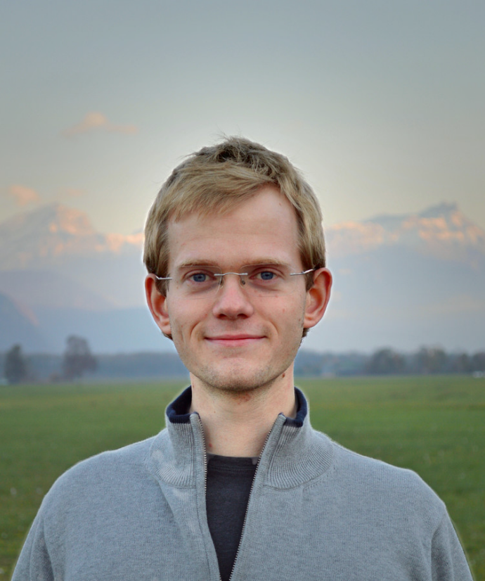
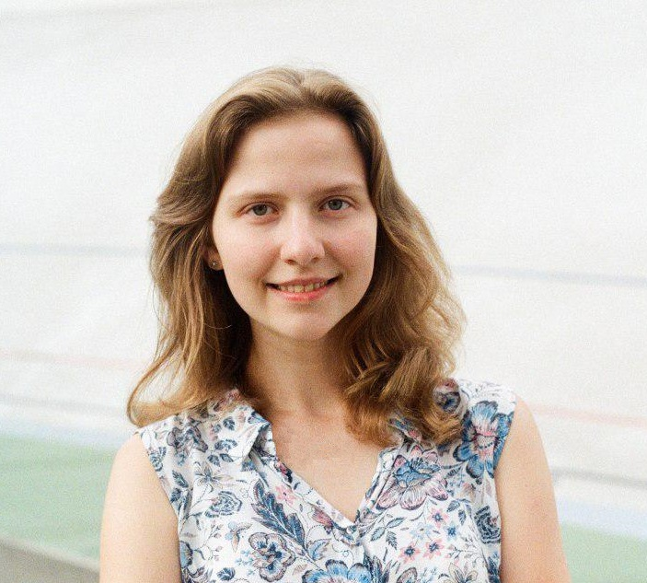
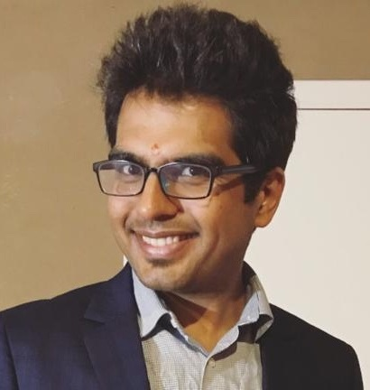

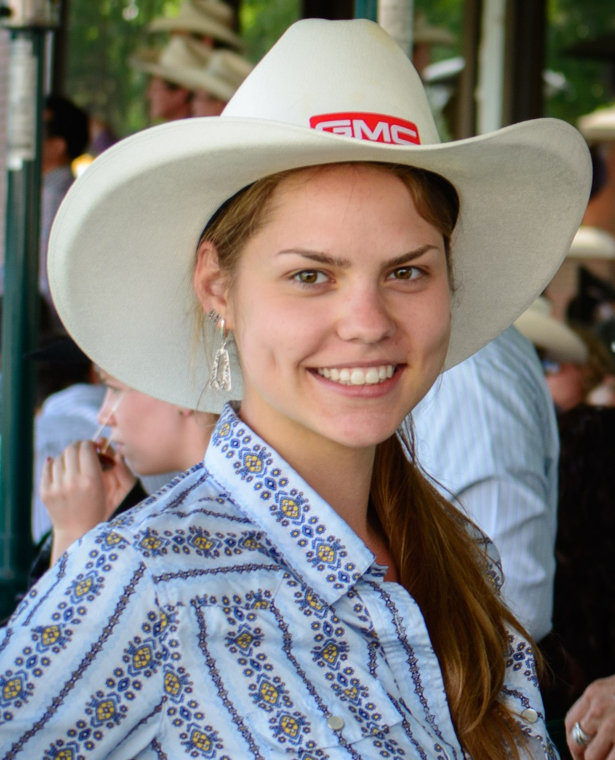

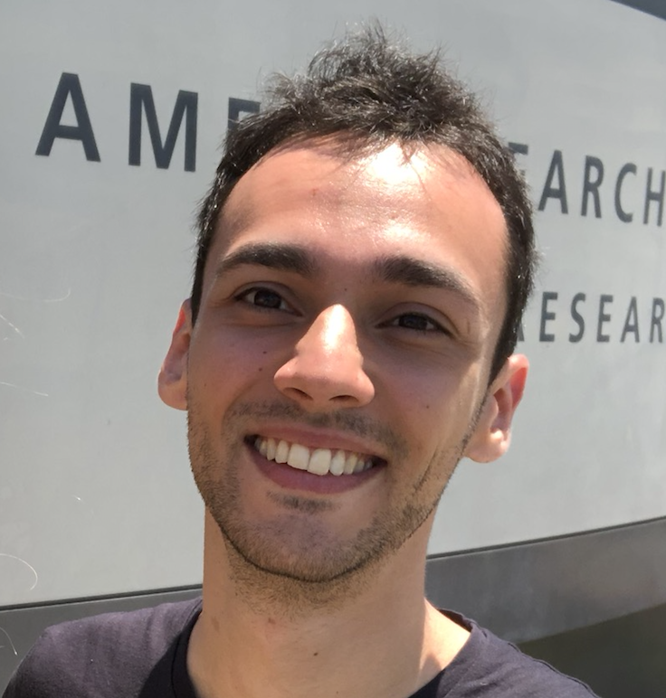
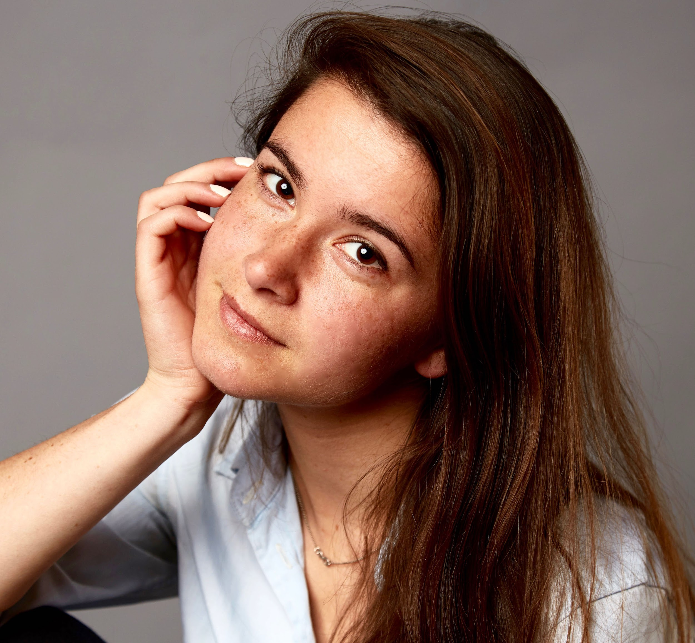
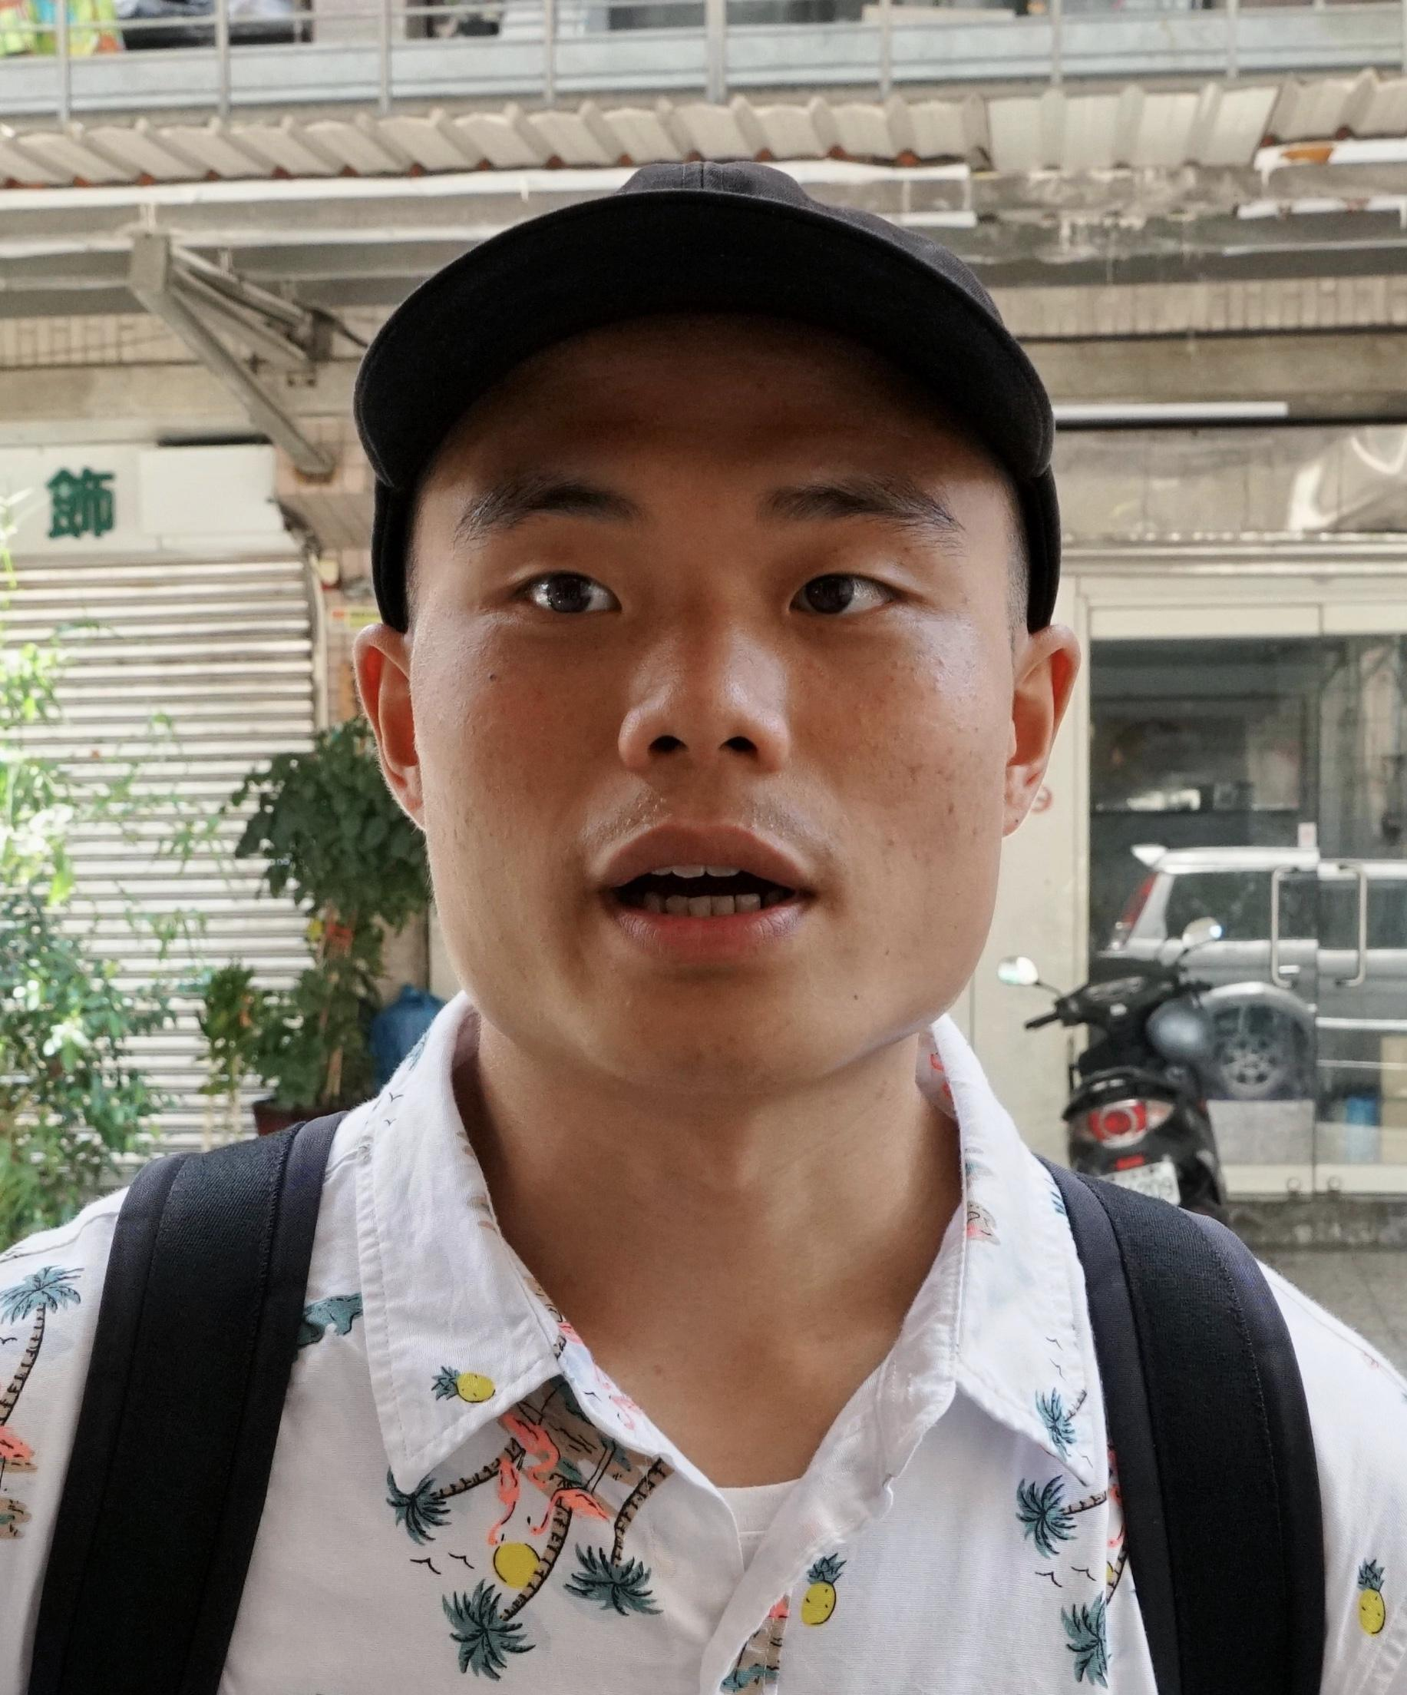

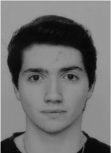





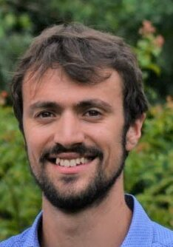
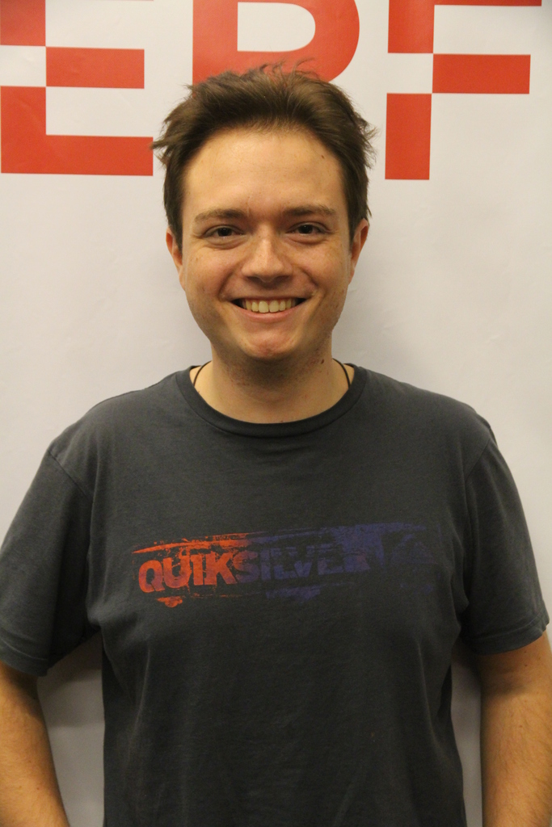
Instructor
Teaching assistants (TAs)
Student assistants (SAs)
Bob
West
Tiziano Piccardi
Kristina
Gligoric
Manoel Horta
Lars
Klein
Anastasiia Kucherenko
Akhil Arora
Valentin
Hartmann
Ekaterina
Svikhnushina
Daniyar
Chumbalov
Halima Schede
Stefano Huber
Olivier Cloux
Jonathan
Labhard
Pablo
Cañas
Davit
Martirosyan
Kuan
Tung
Germain Zouein
Yann
Bouquet
Yasser Haddad
Sylvain
Lugeon
Notes:
Nearly everyone has taken the class, except me

Slide 30

Help each other on Zulip
Participate actively in classes and labs
Give us feedback
Notes:
The team also includes YOU!
Although (and because!) this class is big, we want you to participate
…

Slide 31
Feedback
Give us feedback on this lecture here: https://go.epfl.ch/ada2020-lec1-feedback
Feedback form available for each lecture and lab session
What did you (not) like about this lecture?
What was (not) well explained?
On what would you like more (fewer) details?
What would you like the instructor to (not) wear next time?
…
Notes:
We take feedback seriously, have changed multiple things in response to feedback
Not always implementable in same year; see it as a multigenerational contract
Feedback not the only way in which we try to improve the class (p.t.o.)

Slide 32
Questions?

Slide 33
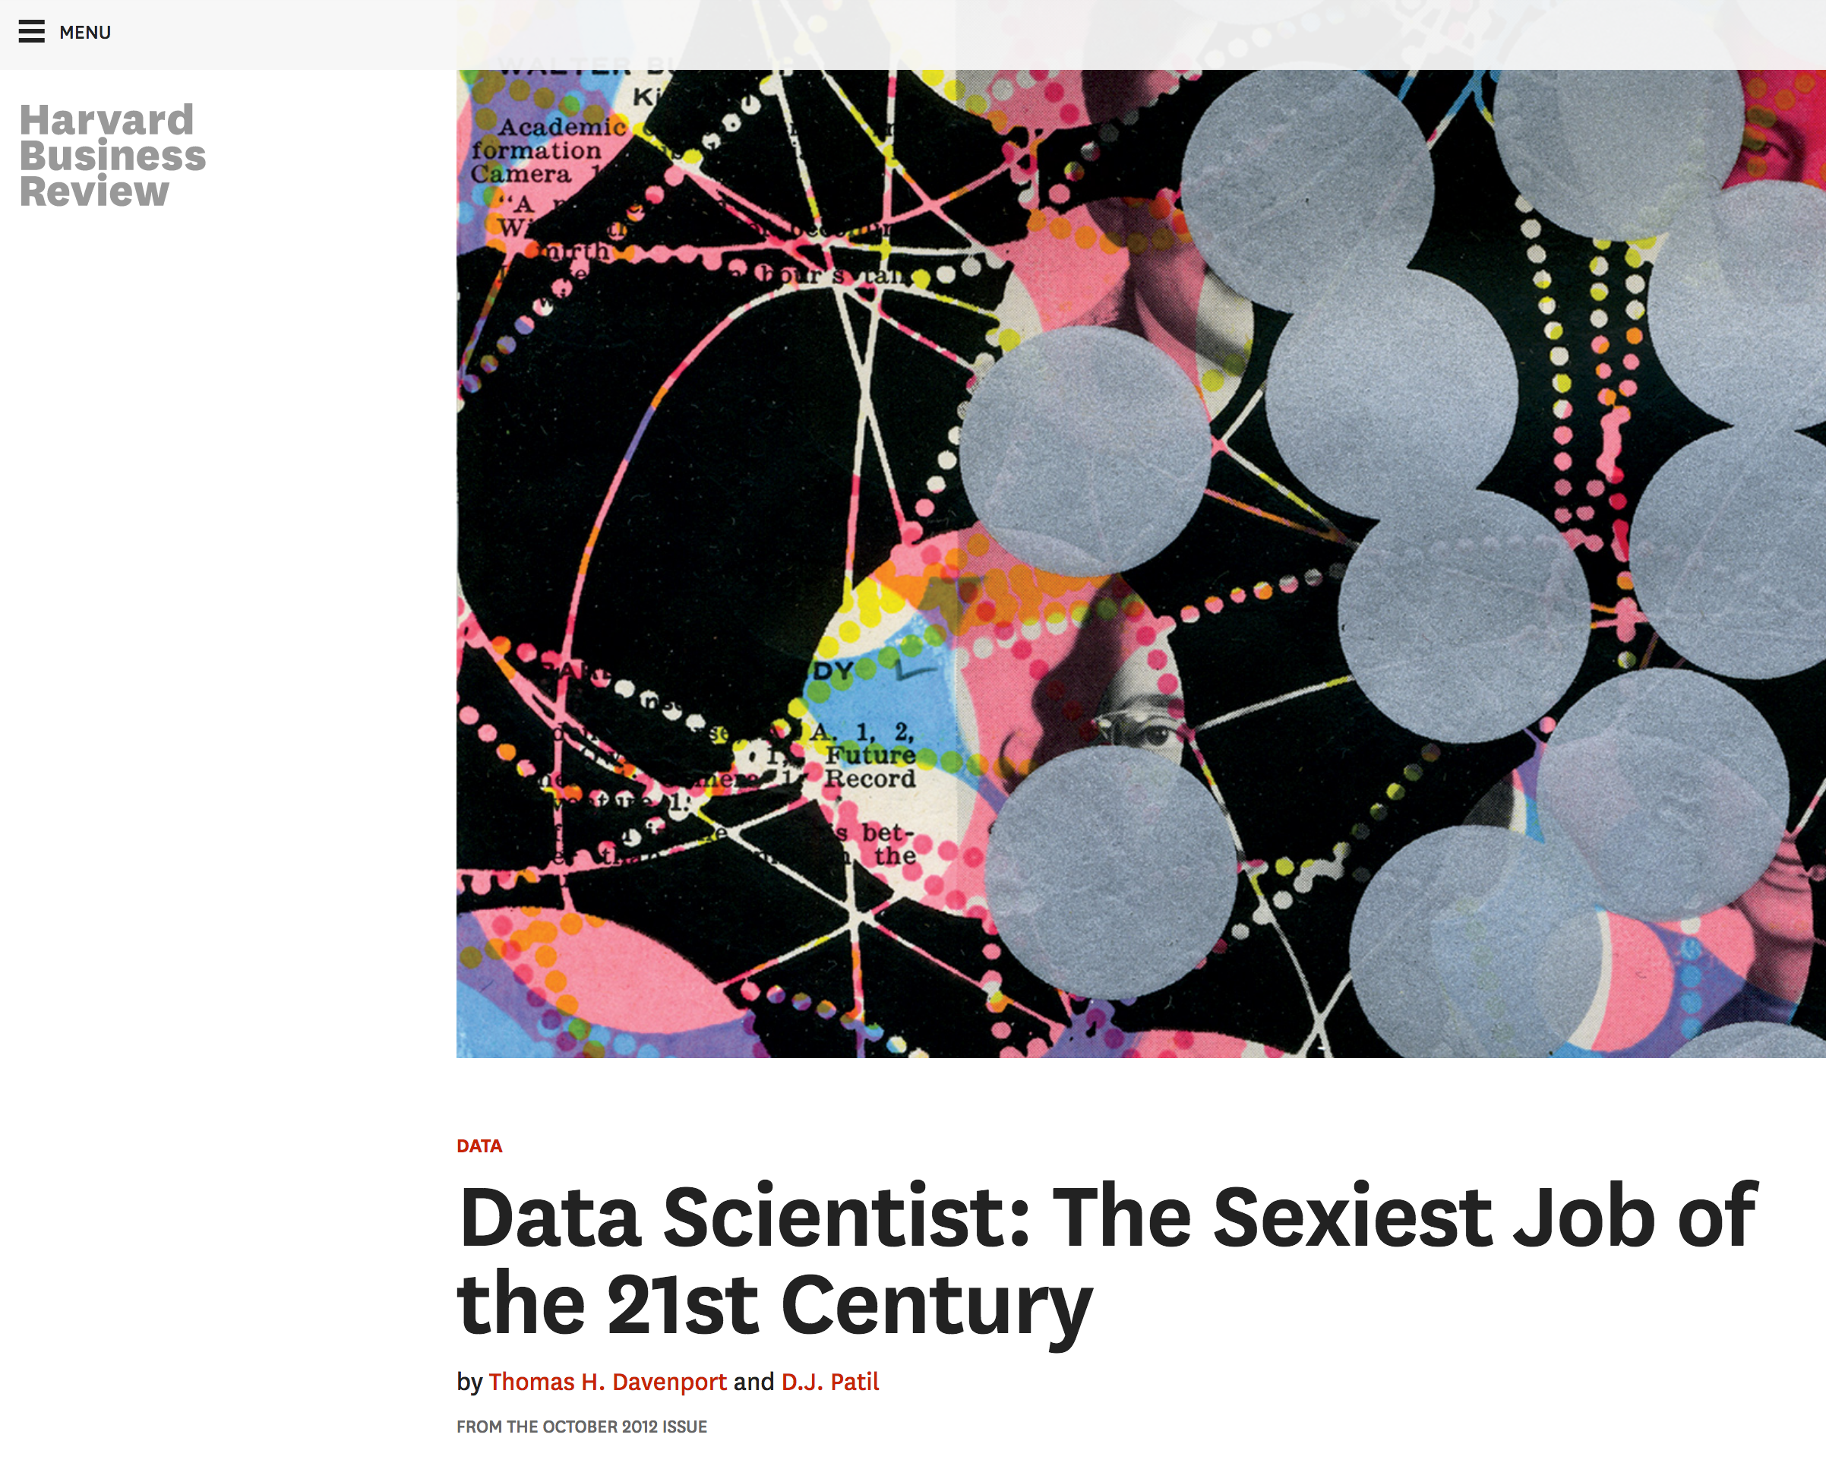
What is data science?
Notes:
Palindromes!

Slide 34
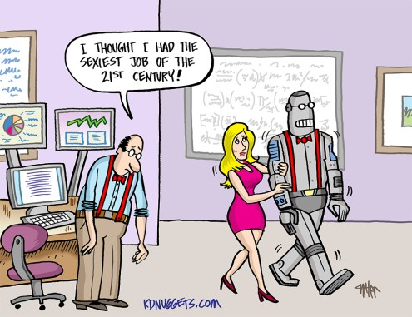
Why now?
I WISH I HAD BECOME A DATA SCIENTIST BACK IN 2020…

Slide 35
“Data science”
All science is (or should be) based on data, per definitionem
So how is “data science” different from plain old “science”?

Slide 36
Data volume explodes
“Between the dawn of civilization and 2003, we only created five exabytes of information; now we’re creating that amount every two days.”
Eric Schmidt, Google (2010)
Notes:
Much more data now

Slide 37
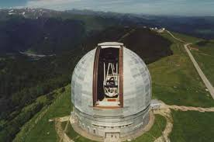
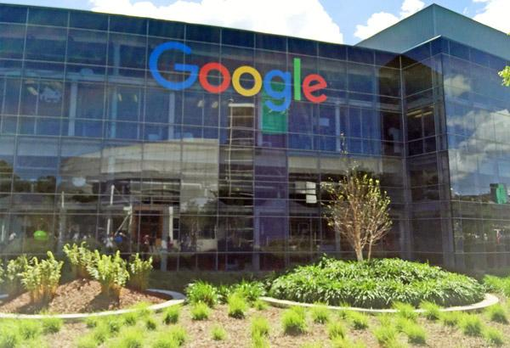
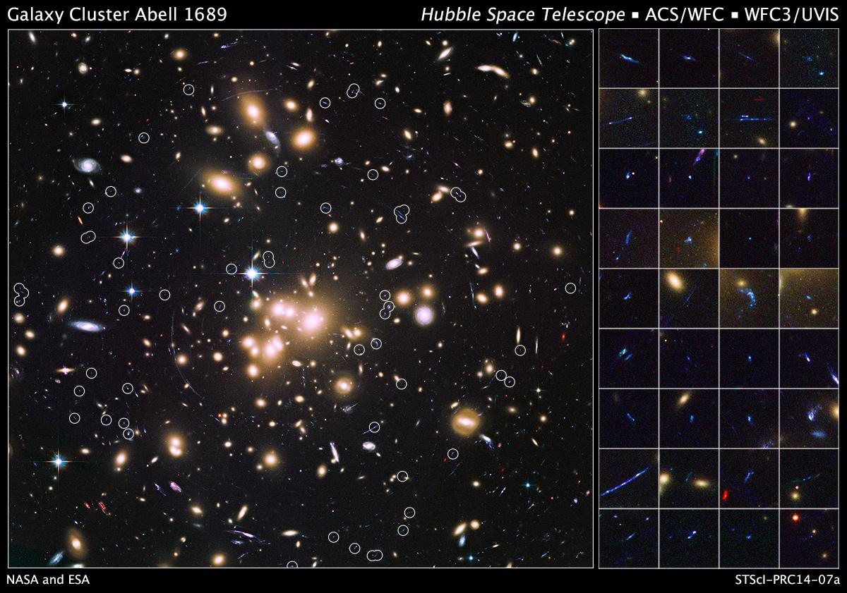
Data variety explodes
Text (indexed Web pages, email), networks (Web graph, Google+, knowledge graph), images, maps, logs (search logs, server logs, GPS logs), speech, …
Notes:
Some scientists have always been collecting huge amounts of data, e.g., astronomy
Now:
Everyone does
much more variety

Slide 38
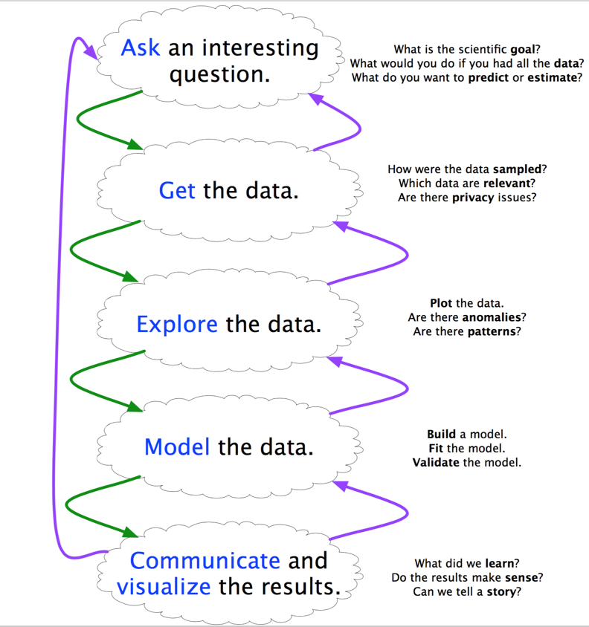
Needed: A method to the madness
Scientific method 1.0: - Focused on “Model the data” - Scientist has hypothesis prior to analyzing the data
Scientific method 2.0: - Systematic cycle (“data science pipeline”) - “Explore the data” becomes increasingly important - Data as a first-class citizen
Notes:
Different from typical ML approach, which starts from algorithm, uses data at the very end for validation
Here we start from data, and keep it in the loop all the time, as our first-class citizen
[diagram]

Slide 39
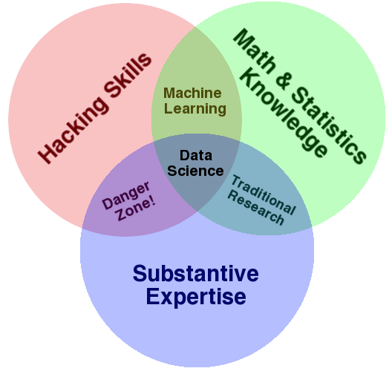
Scientist 2.0

Slide 40
“A data scientist is someone who can obtain, scrub, explore, model, and interpret data, blending hacking, statistics, and machine learning. Data scientists not only are adept at working with data, but appreciate data itself as a first-class product.”
Hilary Mason, chief scientist at bit.ly

Slide 41
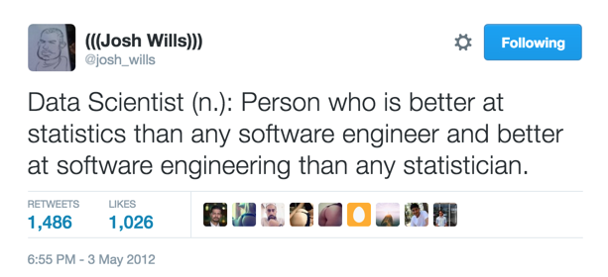
Josh Wills, Data Scientist at Slack

Slide 42
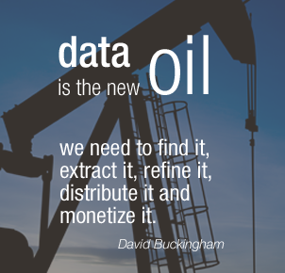
Notes:
Not only science is changed by data -- the whole world is
Economical aspects: …
oil/data is often hard to obtain; precious; but both need to be refined, into plastic/fuel/medicine or insights/products
Value comes only from insights (as with oil)
Internet companies understood this paradigm perfectly (Google, Facebook, Netflix, etc.)

Slide 43
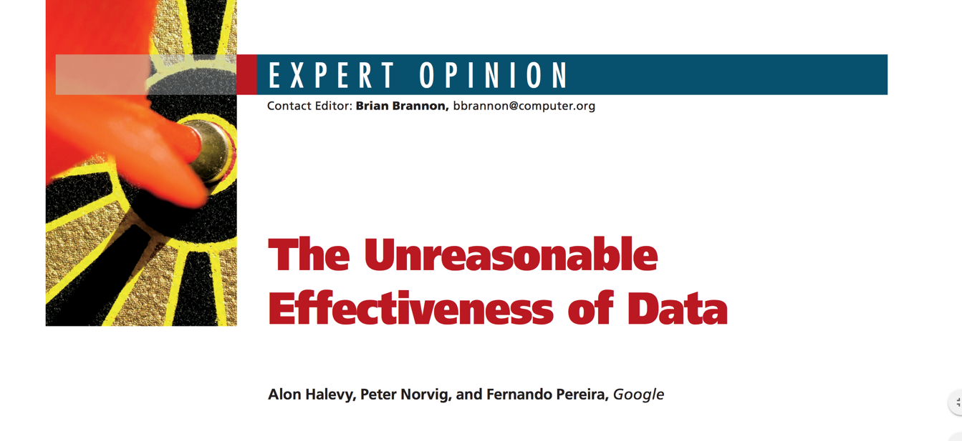
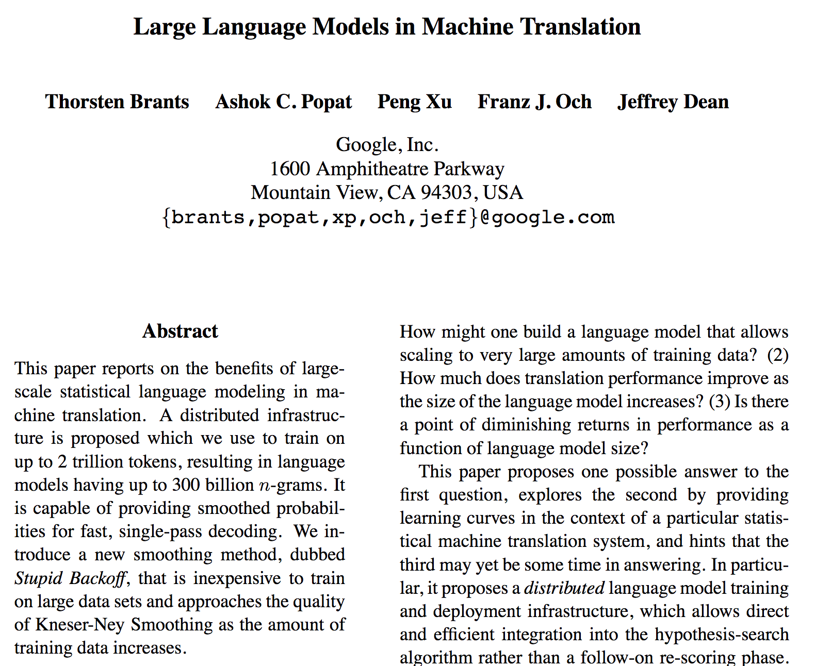
More data often beats better algorithms

Slide 44
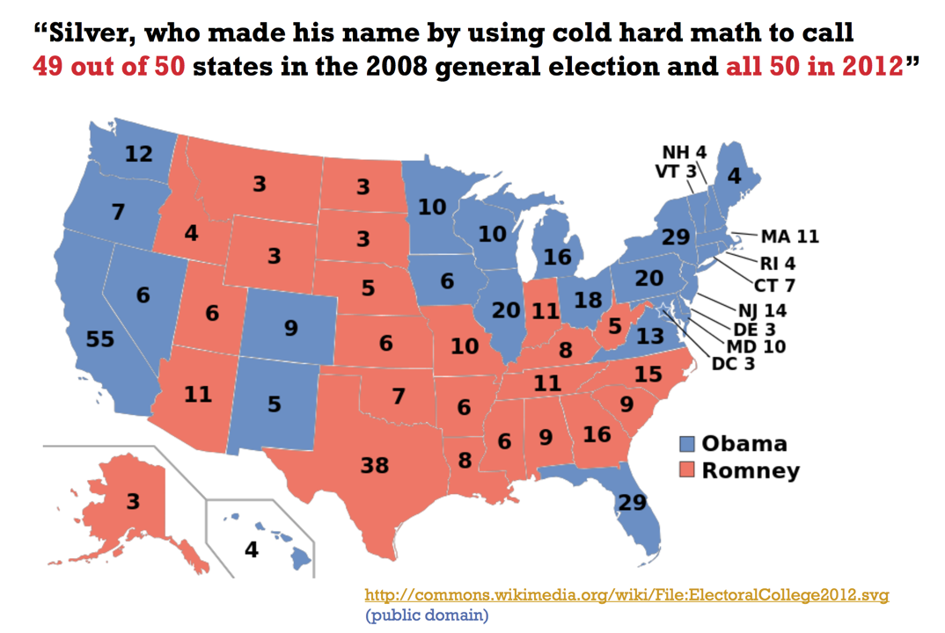
2008, 2012: Predicting elections
Notes:
Societal impact

Slide 45
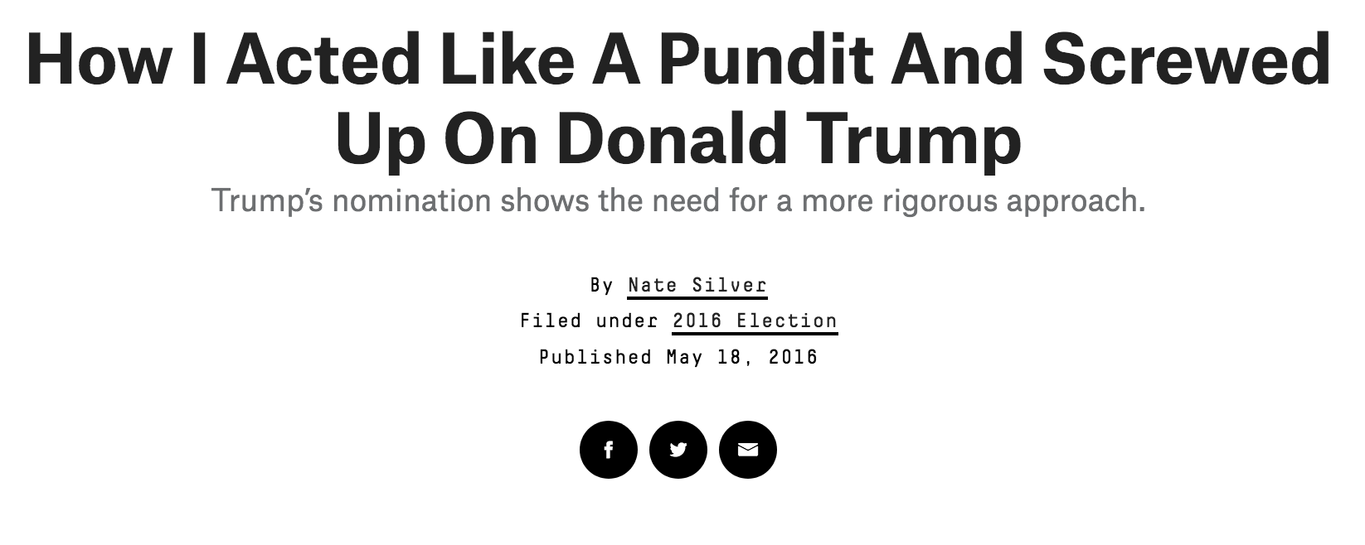
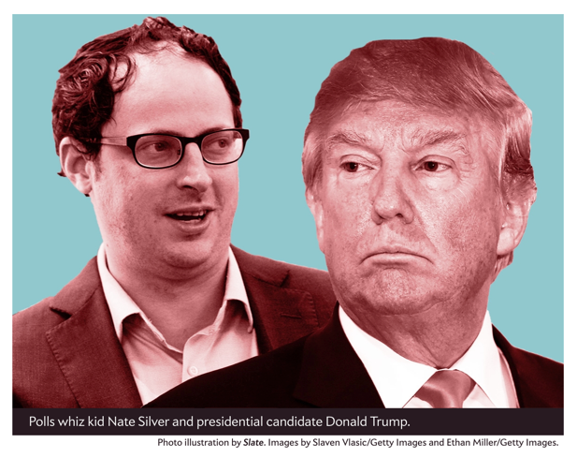
2016: Predicting elections?
Notes:
New situation with little historical data
Wishful thinking
In Silver’s favor: only one data point…

Slide 46

2020:

Slide 47
2008, 2012: Winning elections
"In the 21st century, the candidate with the best data, merged with the best messages dictated by that data, wins.”
Andrew Rasiej, Personal Democracy Forum
“... the biggest win came from good old SQL on a Vertica data warehouse and from providing access to data to dozens of analytics staffers who could follow their own curiosity and distill and analyze data as they needed.”
Dan Woods, CITO Research
Notes:
Rashid Ghani’s talk: sending people to most promising doors
In a nutshell: modern elections are won with data
Still true, and even more drastically so (p.t.o.)

Slide 48



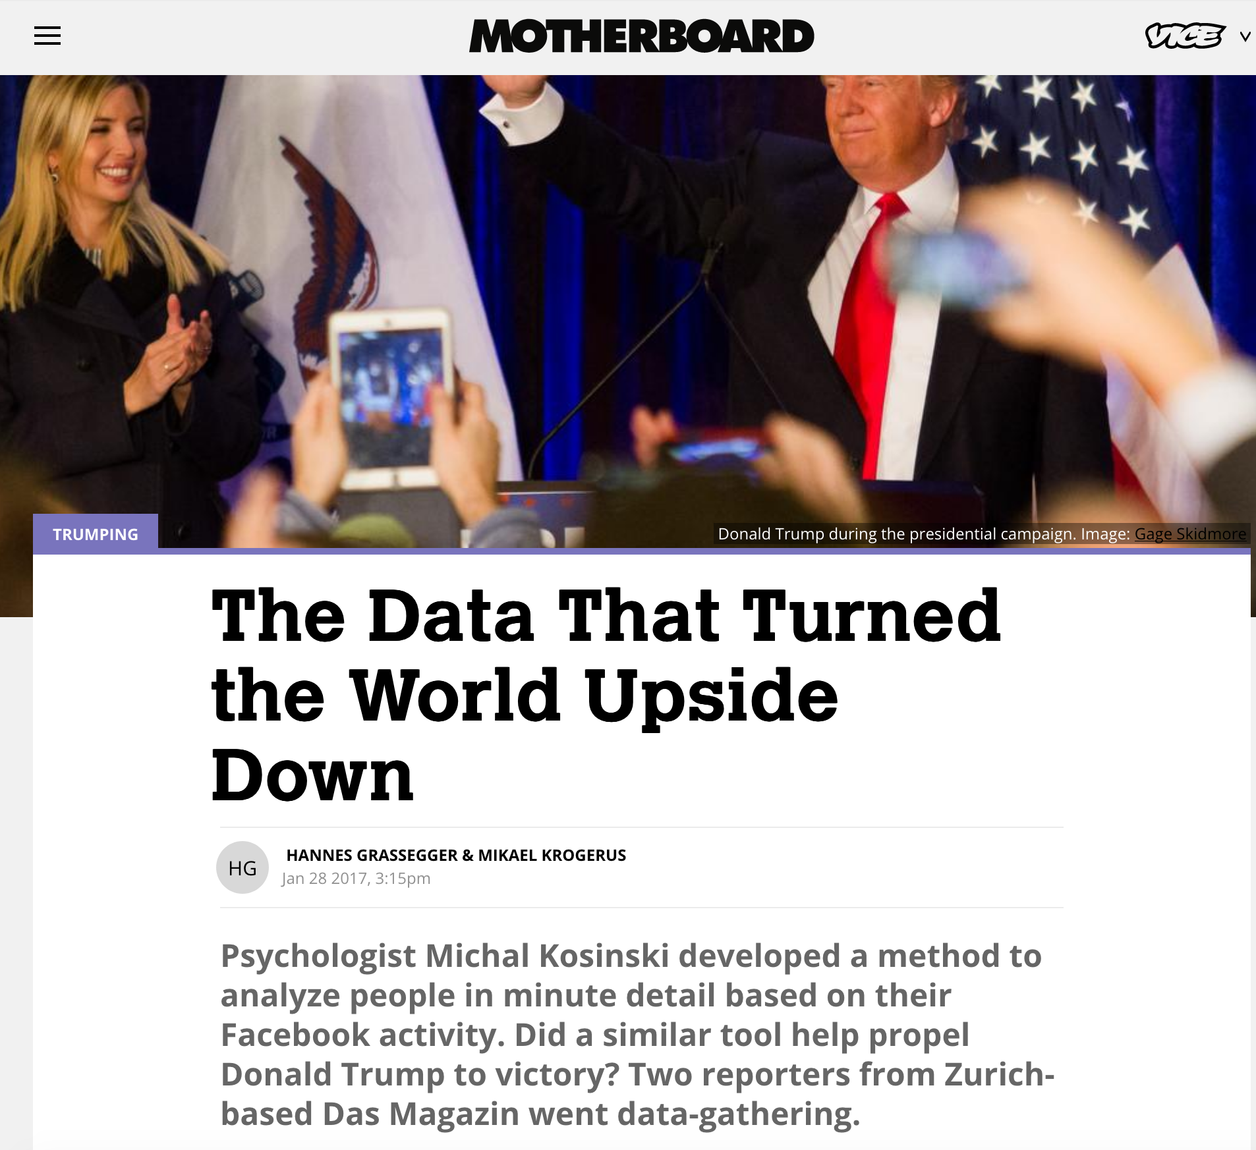
2016: Winning elections
Notes:
Data scientists required both for creating and uncovering such campaigns

Slide 49

2020:
Notes:
Source: https://www.politico.com/news/2020/09/06/trumpyoutube-election-comeback-408576
Frontlines are moving: FB → YT

Slide 50
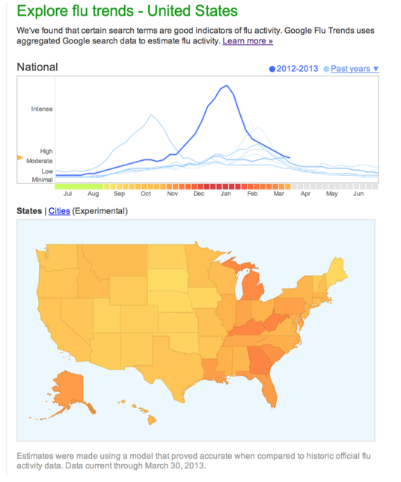
Google Flu Trends
Now discontinued…
“Scientific hindsight shows that Google Flu Trends far overstated this year’s flu season...”
“Lots of media attention to this year’s flu season skewed Google’s search engine traffic.”
Notes:
Need to consider the entire ecosystem from which data is collected!
E.g., overestimation:
Swine flu 2009
Suggestion of search term “flu” when people search for “fever”, “sneezing”, etc. (a.k.a. “algorithmic confounding”)
But Google now working on personalized models, using cellphone data (mention food-illness study)…
Contact tracing

Slide 51
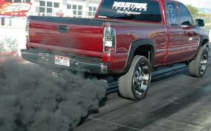
Take care when using oil or data…
[link]
Notes:
Data is like oil in this respect, too:
Need to be careful how we use it!

Slide 52

CHAT ROULETTE!
Think for 1 minute and write down
2-3 things you are excited to do with data science!
Then: chat with a fellow student for 3 minutes
Rolex Forum: Look left; if left neighbor already has partner (or you have no left neighbor), pair up with right neighbor
Zoom: You’ll be randomized into small “breakout rooms”
Notes:
A format we will nurture in all lectures
BOB: ask some to share their thoughts

Slide 53
Skills we are going to develop...
data munging/scraping/sampling/cleaning in order to get an informative, manageable data set
data storage and management in order to be able to access data quickly and reliably during subsequent analysis
exploratory data analysis to generate hypotheses and intuition about the data
prediction based on statistical tools such as regression, classification, and clustering
communication of results through visualization, stories, and interpretable summaries

Slide 54
… and key principles
Use many data sources
Be critical (data is like your friend Steve*)
Be paranoid (data can be your friend-turned-enemy)
Understand how the data was collected (recognize biases)
Use data wisely to remedy biases
Use statistical models (not just hacking around in Excel)
Understand correlations (!= causations)
Communicate your results clearly and carefully
* This statement won’t make sense if you didn’t attend class.

Slide 55
TODO before Friday’s lab session
Sign up for Zulip here and install clients (desktop and mobile)
If you’re not on GitHub yet, sign up for GitHub
Get ready to look for 2 teammates
You may use stream “#Group formation” on Zulip
Check out Google Colab here
Check out Tutorial 0 here

Slide 56
Any feedback? -- Let us know!
Give us feedback on this lecture here: https://go.epfl.ch/ada2020-lec1-feedback
Feedback form available for each lecture and lab session
What did you (not) like about this lecture?
What was (not) well explained?
On what would you like more details?
What would you like the instructor to wear next time?
…

